Slide 1
Federal Income Tax
Exactly as shown on your Form W2
Leave Blank For Now! Remember to fill in before sending.
Optional
Current Address, not one listed on W2 if it has changed.

Slide 2
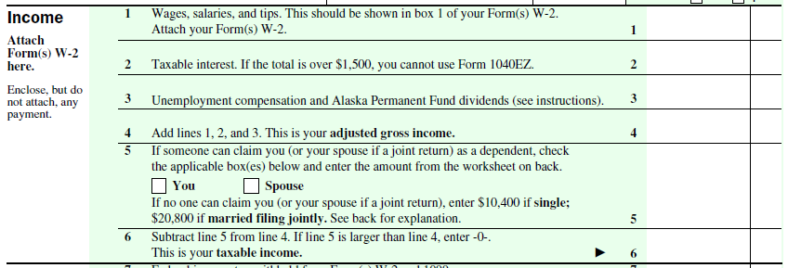
From Box 1 of all forms W2. Make sure to include tips or other cash payments you received during the year.
From Form 1099-INT This should include any interest earned on savings accounts even if you did not receive a 1099-INT.
Total 1, 2, and 3
Enter amount from worksheet
Most likely “YOU” If unsure, check with your parent/guardian.
If you checked this box, do the worksheet to see what your deduction amount is to enter on Line 5.
Line 5 – Line 4 = Line 6
IF LINE 5 > LINE 4 enter 0

Slide 3
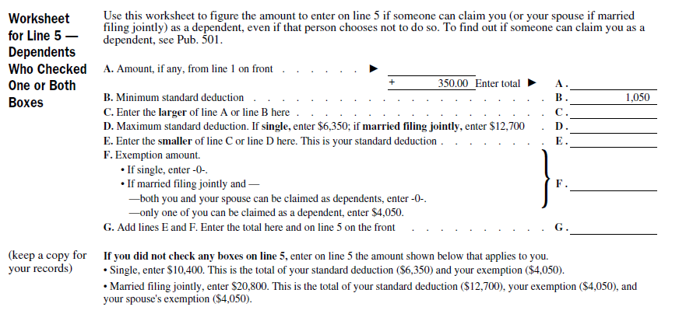
If you checked “YOU” on line 5, you must figure your deduction using the following worksheet.
Enter amount from Line 1 above
Enter this amount on Line 5 above

Slide 4
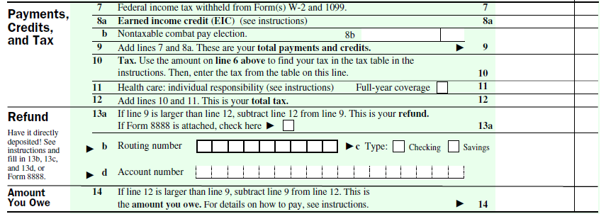
Enter amount from Box 2 of all forms W2
Line 7 + Line 8a = Line 9
Use Line 6 above to find your tax on the tax table and fill it in on Line 10.
Check with your parent/guardian to see if you were covered. If so, check this box and enter zero on line 11
Line 10 + Line 11 = Line 12
Use this section only if you want your refund directly deposited to your account.
IF Line 9 > Line 12:
Line 9 – Line 12 = Line 13a
This is your refund amount

Slide 5
Check NO unless you want someone else to discuss your taxes with the IRS
Sign your name in your very best cursive
Your occupation is Student

Slide 6
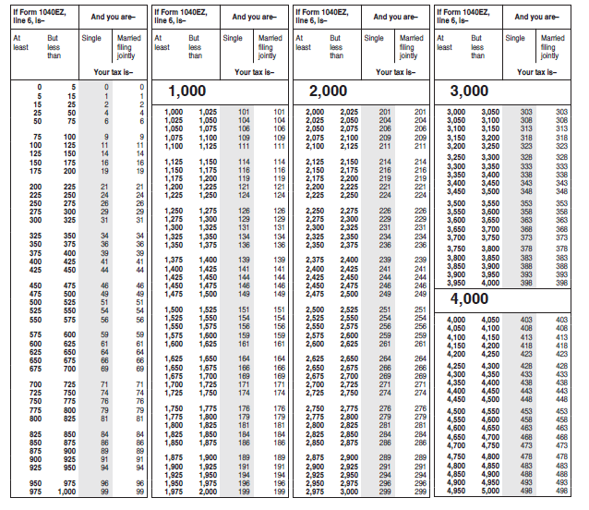
Use Line 6 above to find your tax on this table and fill it in on Line 10 above.
If Line 6 is more than $5000, please ask for help.
Back to Slide 4.

Slide 7
Last Reminders…
1. Make sure to fill in your Social Security number before sending in return.
2. If mailing your return, use one of these addresses:
Receiving a Refund
Sending a Check
Department of the Treasury
Internal Revenue Service
Fresno, CA 93888-0014
Internal Revenue Service P.O. Box 802501
Cincinnati, OH 45280-2501
3. Save copies of your Federal return. You will need one for your own records and one to send in with your State tax filing.
4. Make sure to send the correct copy of each of your forms W2 with your return.
5. If you choose to E-File your return, use this link: Free File Options

